Slide 1
Etl (Extract transform load)
[Manual Testing]
Presented By – Dipanjana Roy

Slide 2
Agenda
Solution Architecture Setup
ETL - Overview and Operations
Data Warehouse Platform - Overview and Operations
Data Model – Facts and Dimensions
Data Marts - Aggregates
BI Tool

Slide 3

Solution Architecture Setup
BI Tool
Data Warehouse
ETL
Data Sources

Slide 4
Solution Architecture Setup
Modules in solution architecture
Extraction And Transformation (ETL)
Data Warehouse / Data Analytics Platform
Business Intelligence (BI) and Reporting

Slide 5
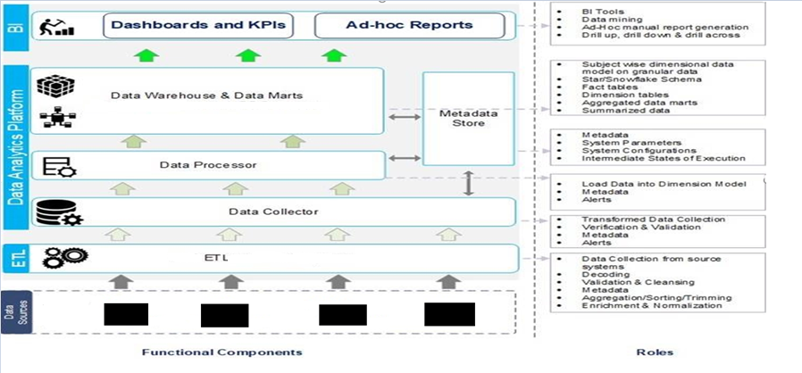
Solution Architecture Setup

Slide 6
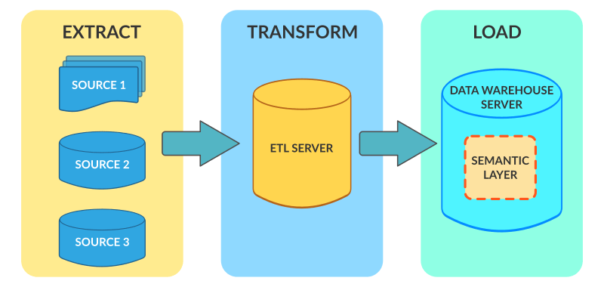
ETL – Overview and Operations

Slide 7
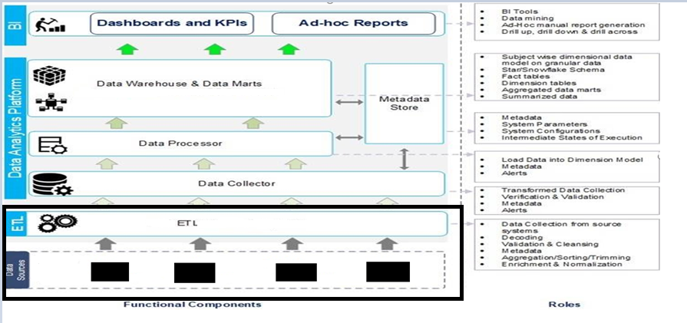
ETL – Overview and Operations

Slide 8
ETL – Overview
ETL stand for Extract – Transform – Load
ETL is a process that involves extracting data from multiple sources in various formats, transforming it to fit business needs, and ultimately, loading it into a target system (data warehouse)
The purpose of ETL is to reformat, cleanse and standardize data so that it can be analysed or exchanged to address business needs and/or promote interoperability
ETL ensures complete transfer of data and processing

Slide 9
ETL - Operations
Extract data from multiple sources.
Data decoding and extraction from Encoded files.
Considering only certain columns to load.
Translating coded values.
Encoding free-form values.
Deriving a new calculated value.
Date format conversion .

Slide 10

ETL - Operations : Data Extraction
CDR_ID
LOCAL_START_DATE
USAGE_SERVICE_TYPE
DEBIT_AMOUNT
CHARGE_SERVICE_INFO
.
.
.
Normal CDRs

Slide 11
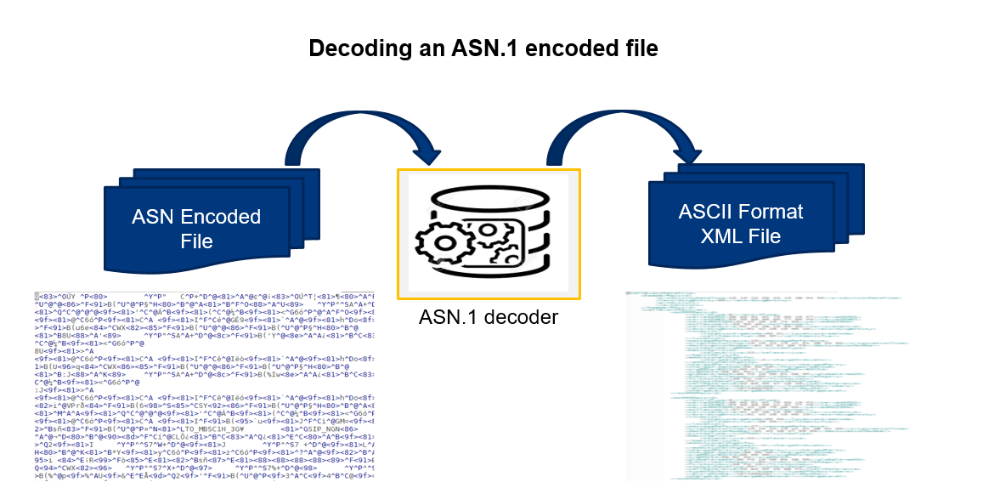
ETL - Operations : Decoding encoded source files

Slide 12
ETL - Operations : Data filtering, Data formatting
Data Filtering
CDR_ID
LOCAL_START_DATE
USAGE_SERVICE_TYPE
DEBIT_AMOUNT
.
.
.
.
Normal CDRs

Slide 13
ETL - Operations : Data filtering, Data formatting
Data formatting
CUST_LOCAL_START_DATE = 20190713142315
CUST_LOCAL_END_DATE = 20190713142353
MSISDN1 = 99XXYYXXYY
MSISDN2 = 99YYXXYXXY
START_DATE (GMT Date) = 20190713082315
CUST_LOCAL_START_DATE = 2019-07-13 14:23:15
CUST_LOCAL_END_DATE = 2019-07-13 14:23:53
MSISDN1 = +9199XXYYXXYY
MSISDN2 = +9199YYXXYXXY
START_DATE (GMT+6) = 2019-07-13 14:23:15

Slide 14
ETL - Operations : Data Correlation
Source - 1
After Correlation
CDR_ID
MSISDN
Datetime
Usage
Originating No.
Destination No.
IMSI
CDR_ID
MSISDN
Sub. Type
Datetime
Rate Plan
Usage
Originating No.
Destination No.
IMSI
Cell Id
MCC & MNC
Status Code
IMEI
Source - 2
Cell Id
Date Time
Subscriber ID
MCC & MNC
Status Code
IMEI

Slide 15
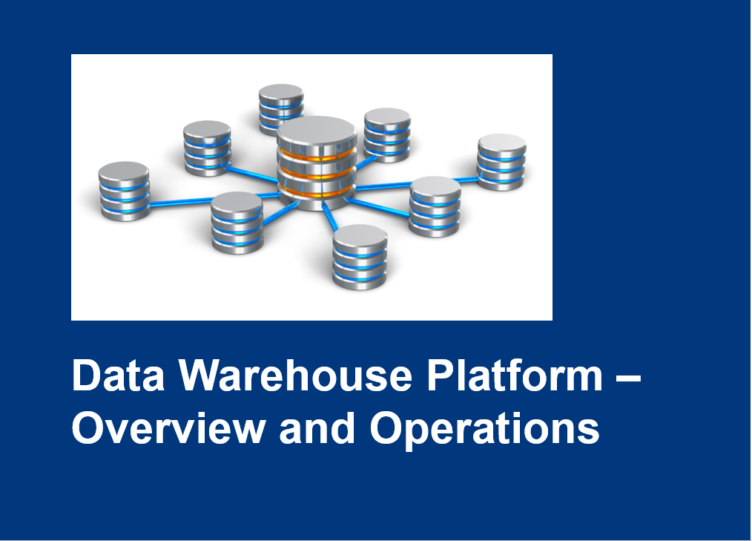

Slide 16
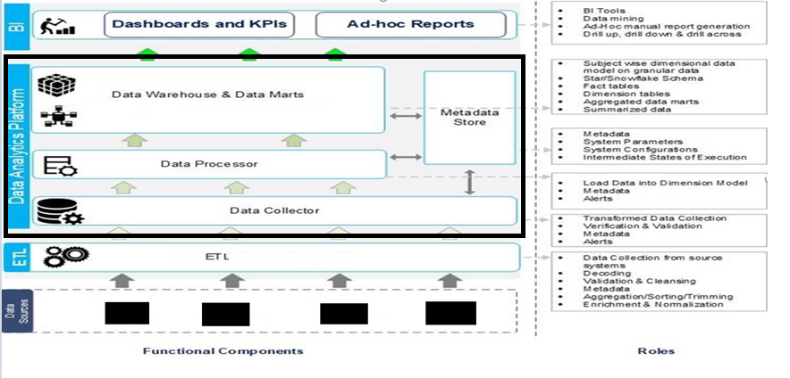
Data Warehouse Platform - Overview

Slide 17
Data Warehouse Platform - Overview
Data collector picks the input feed from ETL. Performs validation and verification of data (MD5SUM, Duplicate file, file prefixes etc.) and sends the file to be processed by Data Processor.
Data Processor performs processing of data by linking the records to appropriate dimensions and prepares the final file to be loaded into Vertica Data model (Facts).
Metadata information about file received and being processed is stored at each stage of DWH platform.

Slide 18
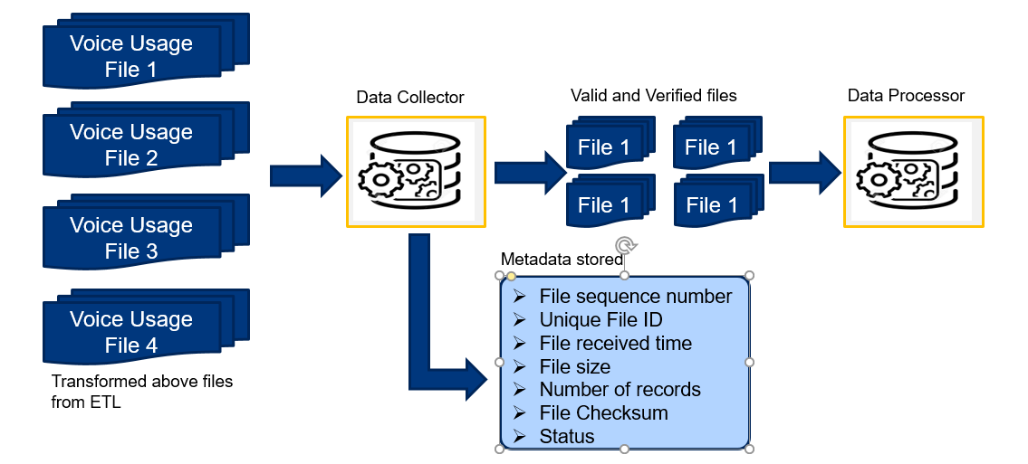
Data Warehouse Platform - Operations

Slide 19
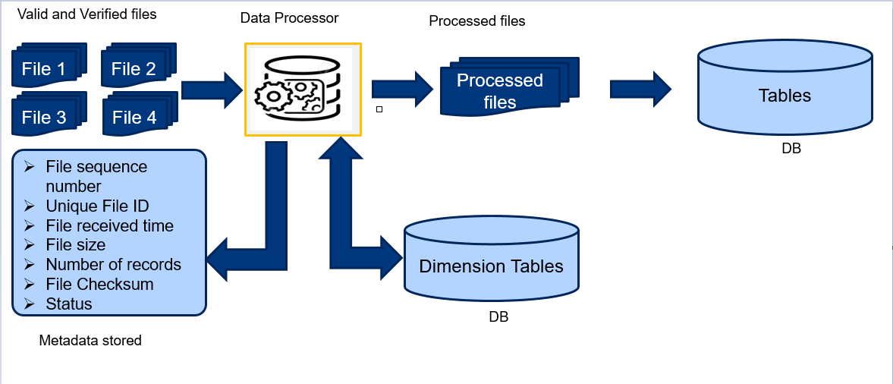
Data Warehouse Platform - Operations

Slide 20
Vertica data model – fact & dimension
Dimension -1
Dimension -1
Dimension -1
Fact -2
Dimension -1
Dimension -1
FACT -1
Dimension -1
Projection
Physical Storage

Slide 21
Vertica Data Model - Facts and Dimensions
In Data Warehouse platform, records are stored in form of Dimensional Data Models .
Facts are the measurements that result from a business process event and are almost always numeric.
Fact table always contains foreign keys for each of its associated dimensions.
Dimensions describe the objects involved in a business intelligence effort.
While facts correspond to events, dimensions correspond to people, items, or other objects.

Slide 22
ETL -STAGING
RDBMS
Staging Area
Data Warehouse
SQL
Flat Files

Slide 23
Vertica Data Model - Facts and Dimensions
Fact Table Dimension linking with fact table
Sequence Number
Service Key
Date Key
Location key
Total Usage
Device Key
D_SERVICE
Service_Key
D_LOCATION
Location_Key
Service Key
Date Key
Location key
Device Key
D_DATE
Date_Key
D_DEVICE Device_Key

Slide 24
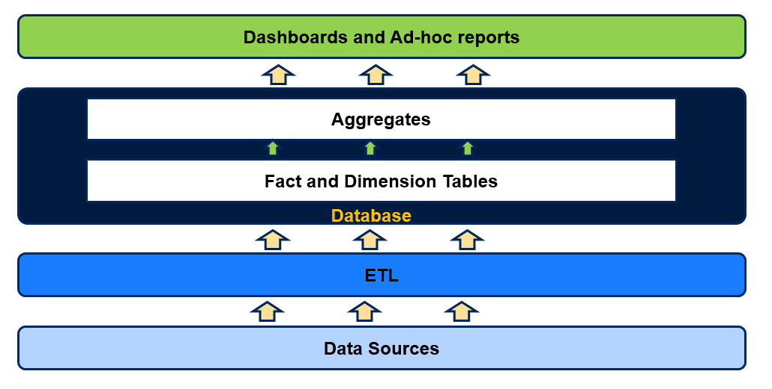
Vertica - Aggregates and Ad-hoc Queries Usage

Slide 25
Aggregates
Aggregates are summarized version of granular transaction level data
Aggregates are created to increase dashboards usage experience in terms of response time
Four levels of aggregates are available in the system
Hourly
Daily
Weekly
Monthly

Slide 26
AGGREGATES
FACT Table
Sequence Number
Service Key
Date Key ( Records stored daily wise)
Location key
Total Usage
Device Key
Total Usage
Daily Table
Sequence Number
Service Key
Date Key
Location key
Total Usage
Device Key
Total Usage
Sequence Number
Service Key
Date Key ( Records stored weekly wise)
Location key
Total Usage
Device Key
Total Usage
Weekly Table
Sequence Number
Service Key
Date Key ( Records stored monthly wise)
Location key
Total Usage
Device Key
Total Usage
Monthly Table

Slide 27
ETL Testing
Basic Test cases : -
Source to Target Data testing
Meta data testing
Data Completeness testing
Data Accuracy testing
Data Transformation testing
Data quality testing
GUI/Navigation testing
Production validation testing

Slide 28

Types of bugs
Source Bugs
Cosmetic Bugs
Version control bugs
Load Condition Bugs
Calculation Bugs
User Interface Bugs

Slide 29
BI Tools
Business Intelligence is the process of collecting raw data or business data and turning it into information that is useful and more meaningful.
BI Tools :
Tableau
IBM COGNOS ANALYTICS
GOODDATA
DOMO
SAP BUSINESSOBJECTS
SAS BUSINESS INTELLIGENCE
DATAPINE

Slide 30
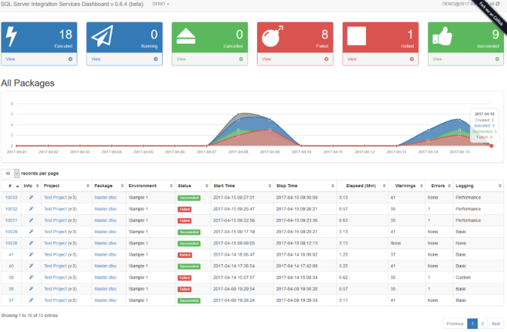
Graphical REPRESENTATION

Slide 31

ANY Questions/ Feedback

Slide 32


